Slide 1
ML Visuals
By dair.ai
Notes:
ML Visuals is a new collaborative effort to help the machine learning community in improving science communication by using more professional, compelling and adequate visuals and figures. You are free to use the visuals in your presentations or blog posts. You don’t need to ask permission to use any of the visuals but it will be nice if you can provide credit to the designer/author (author information found in the slide notes).
This is a project made by the dair.ai community and maintained in this GitHub repo. Our community members will continue to add more common figures and basic elements in upcoming versions. Think of this as free and open artefacts and templates which you can freely and easily download, copy, distribute, reuse and customize to your own needs. I am maintaining this set of slides on a bi-weekly basis where I will regularly organize and keep the slides clean from spam or unfinished content.
IMPORTANT NOTE: Please don’t request editing permission if you do not plan to add anything to the slides. If you want to edit the slides for your own purposes, just make a copy of the slides.
Contributing: To add your own custom figures, simply add a new slide and reuse any of the basic visual components (remember to request edit permissions). We encourage authors/designers to add their visuals here and allow others to reuse them. Make sure to include your author information (in the notes section of the slide) so that others can provide the proper credit if they use the visuals elsewhere (e.g. blog/presentations). Add your name and email just in case someone has any questions related to the figures you added. Also, provide a short description of your visual to help the user understand what it is about and how they can use it. If you need "Edit" permission, just click on the "request edit access" option under the "view only" toolbar above or send me an email at ellfae@gmail.com. If you have editing rights, please make sure not to delete any of the work that other authors have added. You can try to improve it by creating a new slide and adding that improved version (that’s actually encouraged).
Downloading a figure from any of the slides is easy. Just click on File→Download→(choose your format).
If you need help with customizing a figure or have an idea of something that could be valuable to others, we can help. Just open an issue here and we will do our best to come up with the visual. Thanks.
Feel free to ask us anything related to this project in our Slack group.

Slide 2
Basic components
Notes:
Note:
Basic components go here.

Slide 3
Notes:
Note:
This is a simple round rectangle that can represent some process, operation, or transformation
Author: Elvis Saravia (ellfae@gmail.com)

Slide 4
Notes:
Note:
This can be used to represent a vector. If you want to edit the distance between each element, you can “ungroup” the shapes and then modify the distance between the individual lines.
Author: Elvis Saravia (ellfae@gmail.com)

Slide 5
Notes:
Symbolizing an embedding

Slide 6
Notes:
Note:
Can represent a neuron or some arbitrary operation
Author: Elvis Saravia (ellfae@gmail.com)

Slide 7




Softmax
Convolve
Sharpen
Notes:
Note:
These visuals could represent transformations (left) or operations (right)
The visuals on the right use the Math Equations Add on for Google Slides.
If you click on the equation you are able to modify it by:
Selecting Add Ons → Math Equations → Menu
While the equation is selected, click “Connect to Equation” on the “Math Equations UI”
Then change the properties like color, size, etc.
Author: Elvis Saravia (ellfae@gmail.com)

Slide 8




Softmax
Convolve
Sharpen
Notes:
Note:
These visuals could represent transformations (left) or operations (right)
The visuals on the right use the Math Equations Add on for Google Slides.
If you click on the equation you are able to modify it by:
Selecting Add Ons → Math Equations → Menu
While the equation is selected, click “Connect to Equation” on the “Math Equations UI”
Then change the properties like color, size, etc.
Author: Elvis Saravia (ellfae@gmail.com)
Log:
Added a dark theme version of the previous slide

Slide 9
Notes:
Note:
These visuals can represent a multi-directional array (3D) input, tensor, etc.
Author: Elvis Saravia (ellfae@gmail.com)

Slide 10
Architectures
Notes:
Note:
You can add abstract backgrounds here

Slide 11
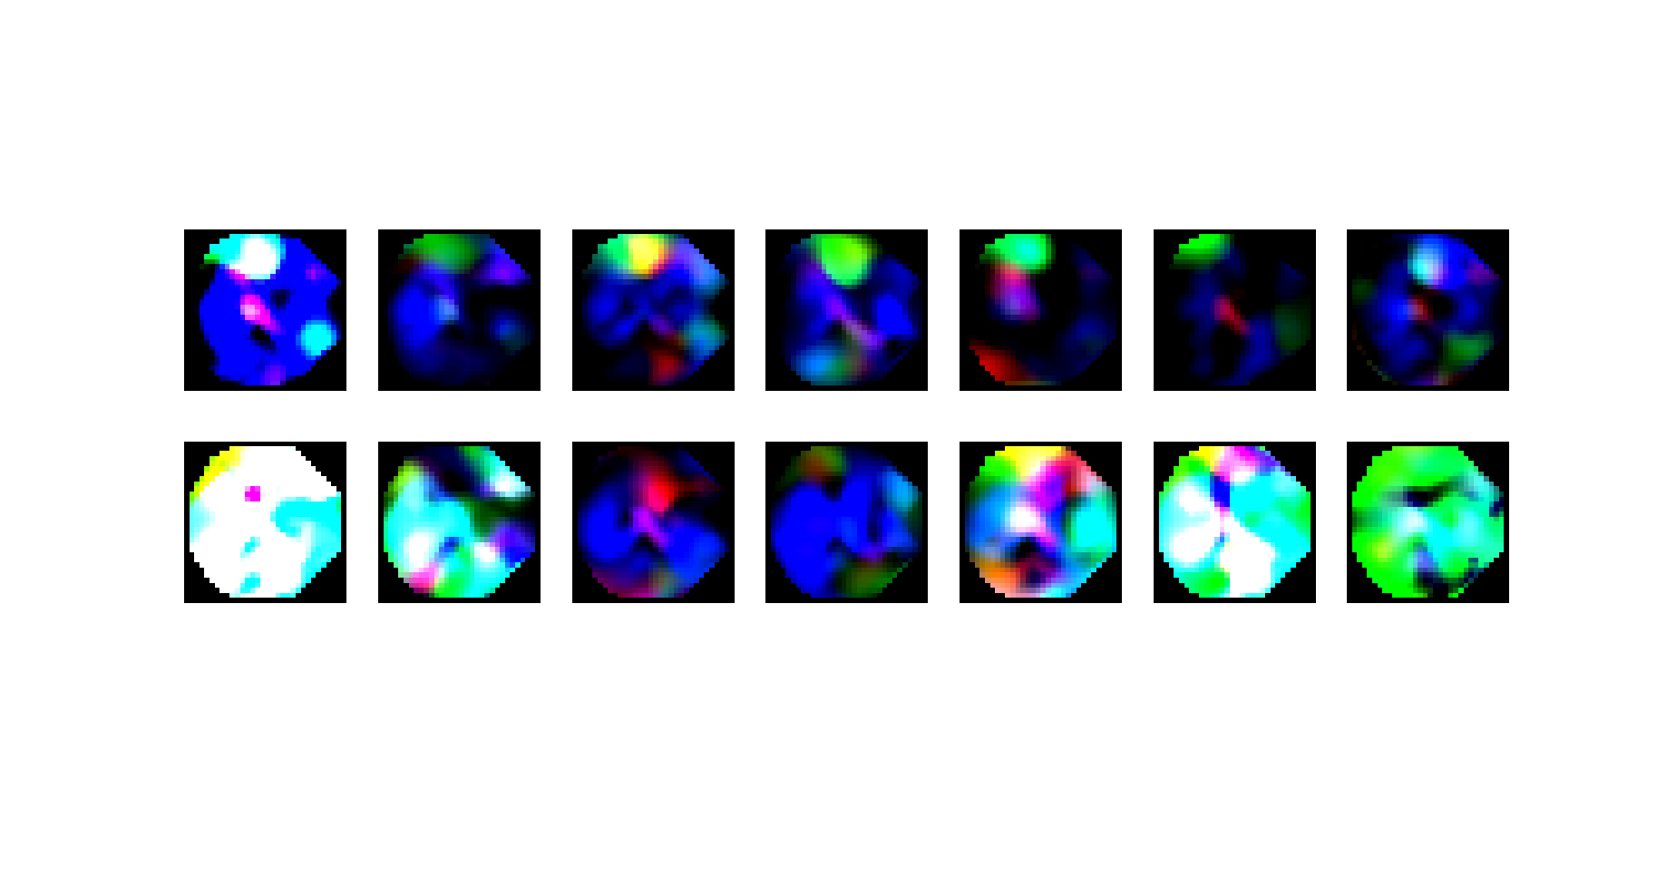
S2
S3
Frame1
Frame2
Frame3
Frame4
Frame5
Frame6
Frame7

Slide 12
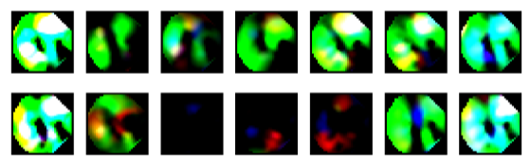
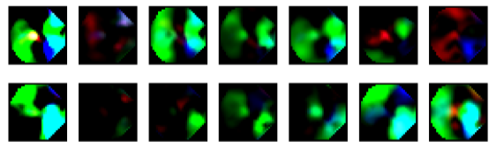
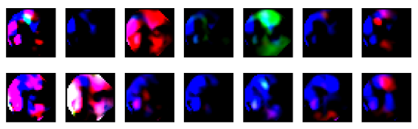
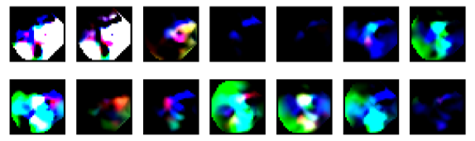
Sample1
Level 1
Sample2
Sample1
Level 2
Sample2
Sample1
Level 3
Sample2
Sample1
Level 4
Sample2
Frame1
Frame2
Frame3
Frame4
Frame5
Frame6
Frame7

Slide 13
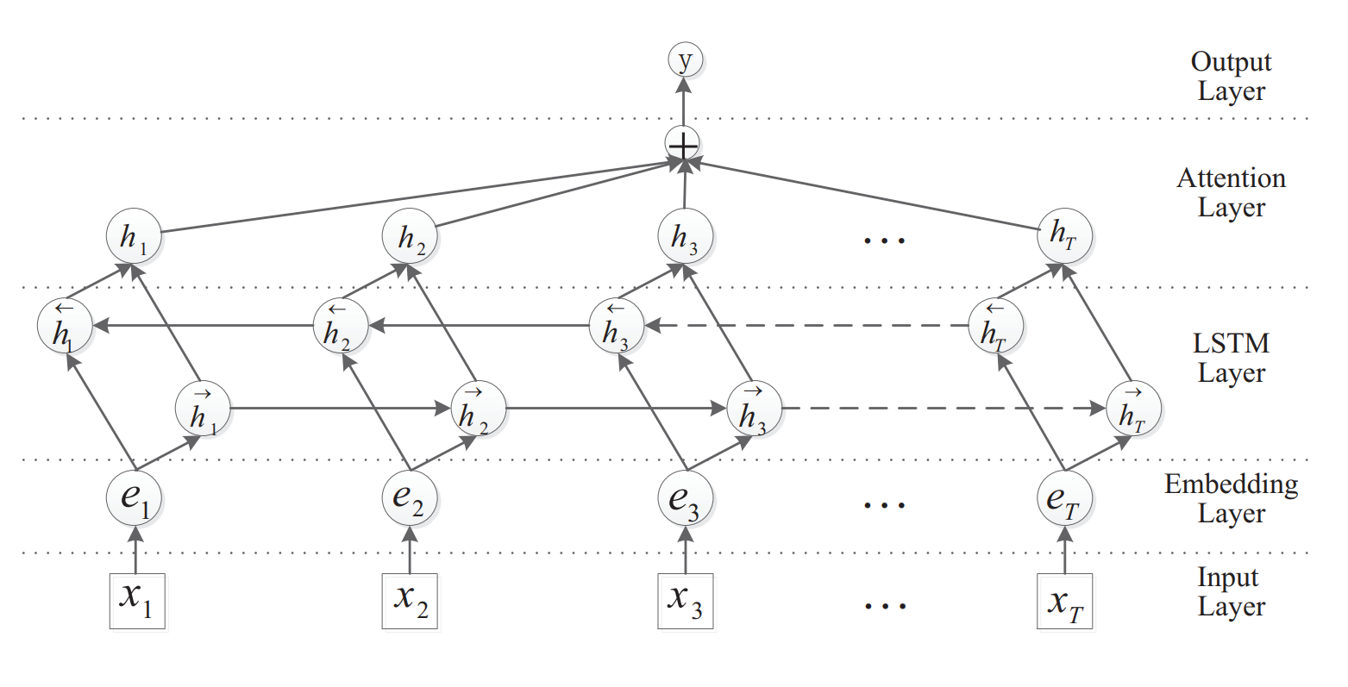
C
C
C
CNN
Layer

Slide 14
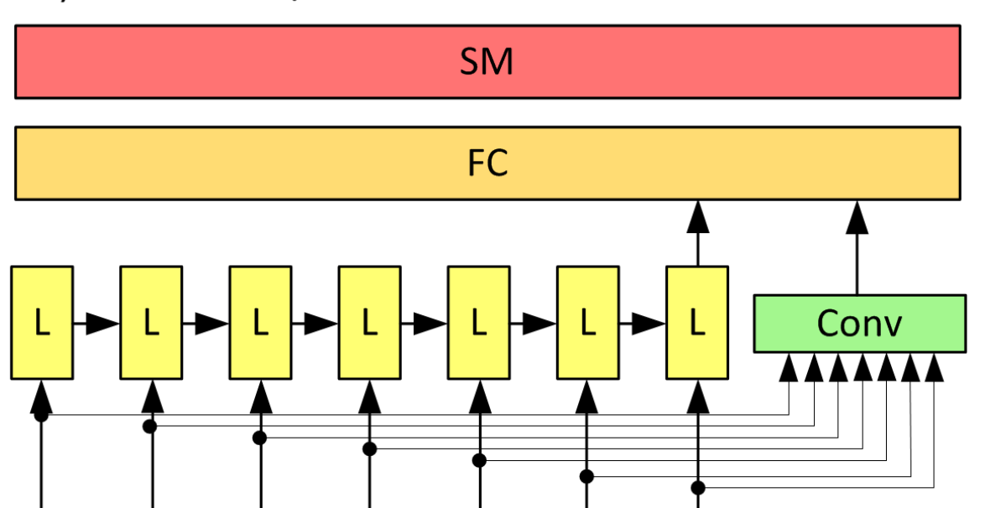
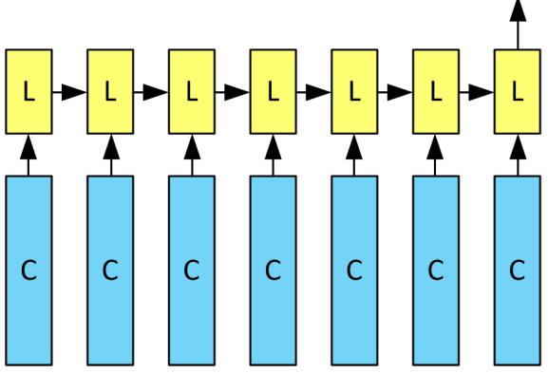

Slide 15
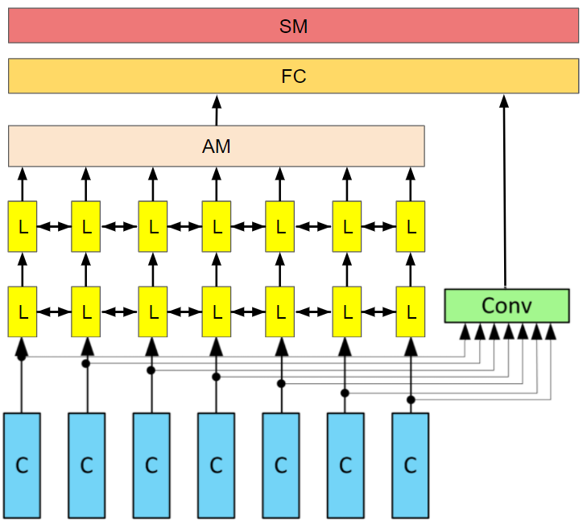

Slide 16
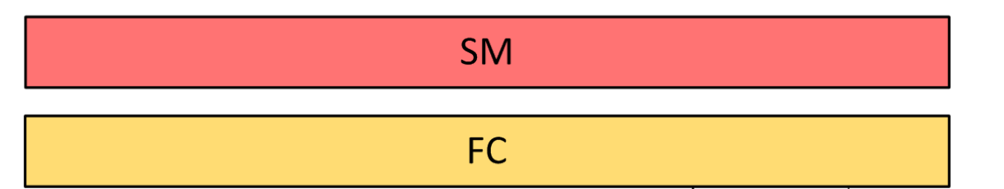
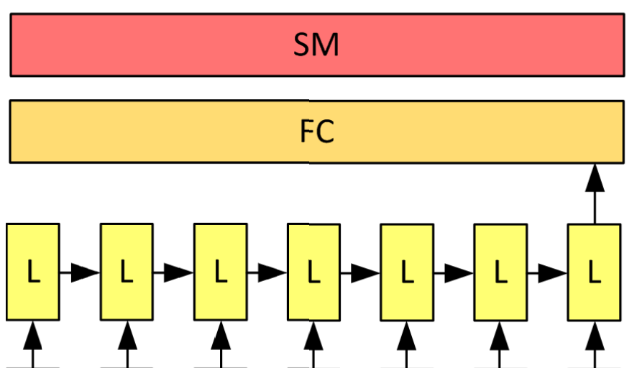

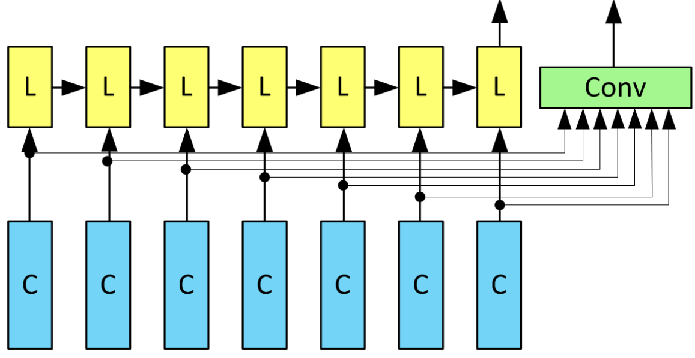

Slide 17
Input
Conv3-32
x4
Maxpool
Conv3-64
x2
32x32x3
Maxpool
(2x2)
Conv3-128
x1
Maxpool
(2x2)
Output
FC-512
Feature
Vector

Slide 18
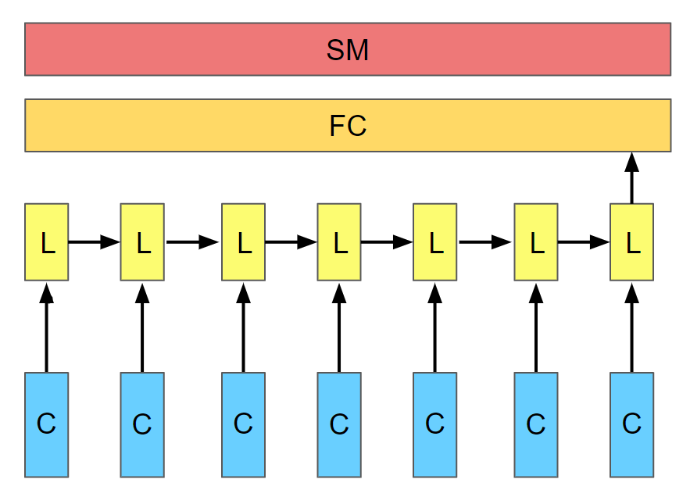
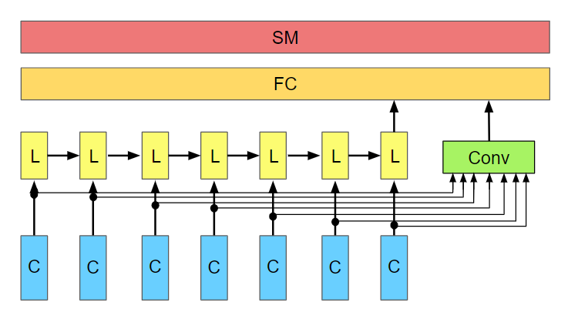
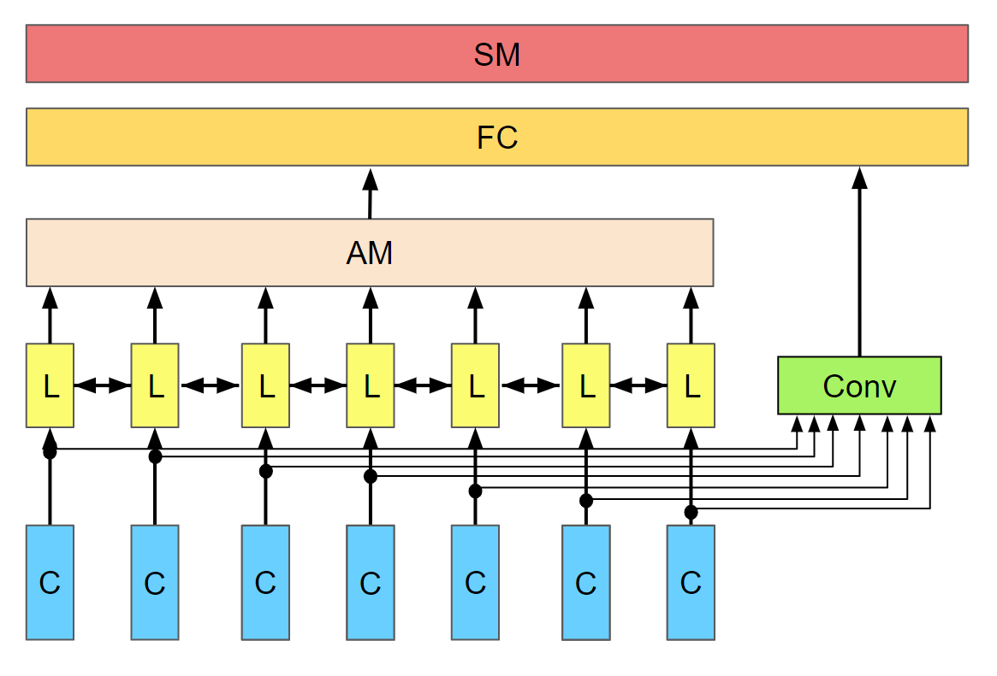
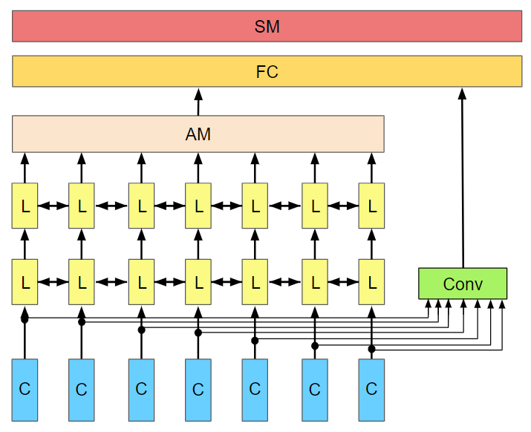

Slide 19
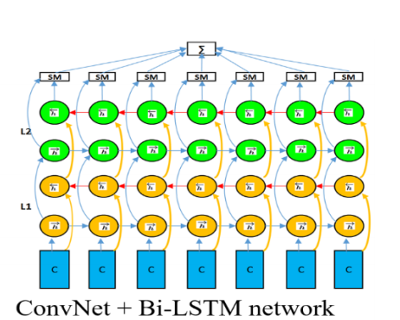
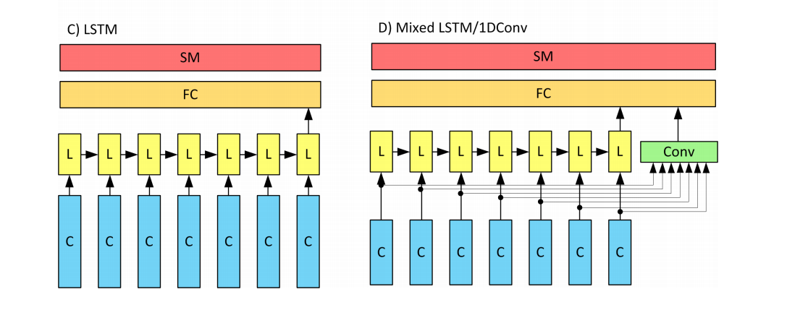
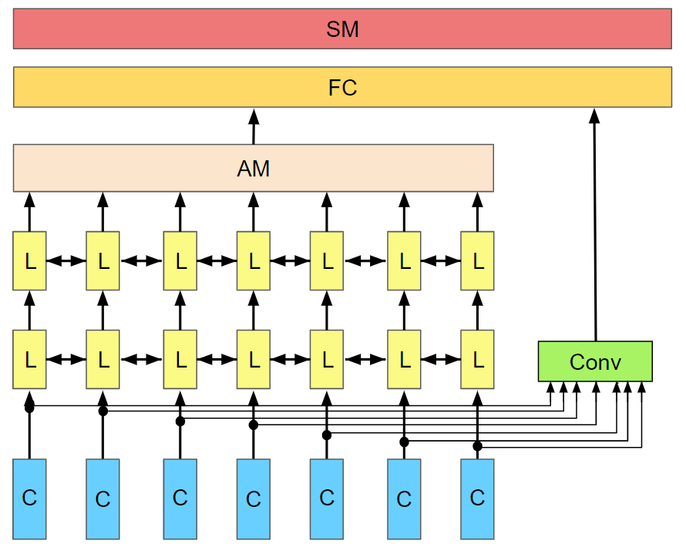
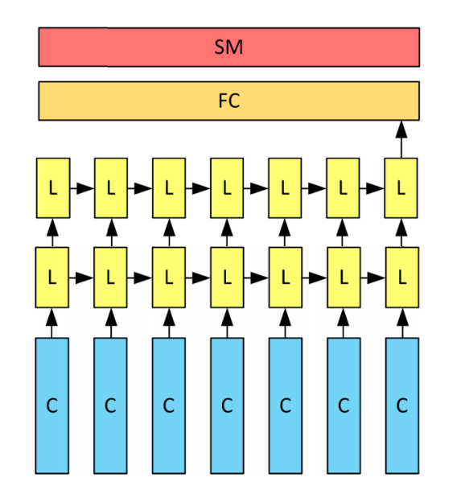
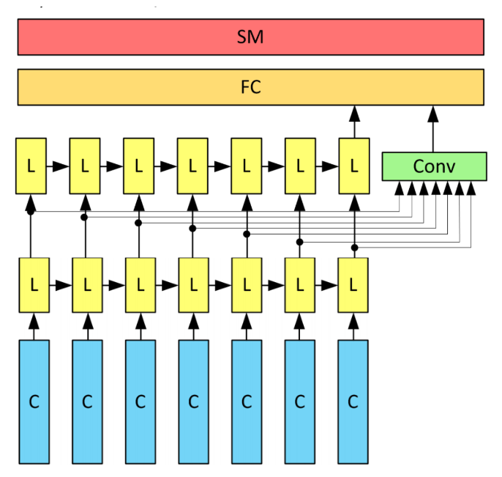
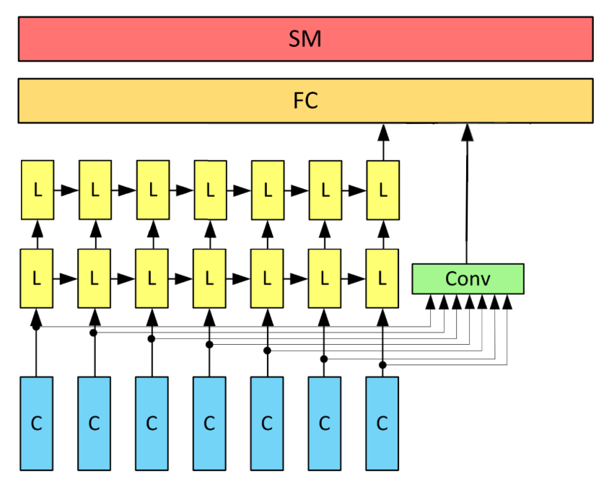
Notes:
Note:
Can represent a multidimensional array (2D)
Author: Elvis Saravia (ellfae@gmail.com)

Slide 20
SM
FC
AM
L
L
L
L
L
L
L
L
L
L
L
L
L
L
Conv
C
C
C
C
C
C
C

Slide 21
SM
FC
L
L
L
L
L
L
L
Conv
C
C
C
C
C
C
C

Slide 22
SM
FC
L
L
L
L
L
L
L
L
L
L
C
C
C
C
C
C
C
C
C
C

Slide 23
SM
FC
Conv
C
C
C
C
C
C
C
C
C
C

Slide 24
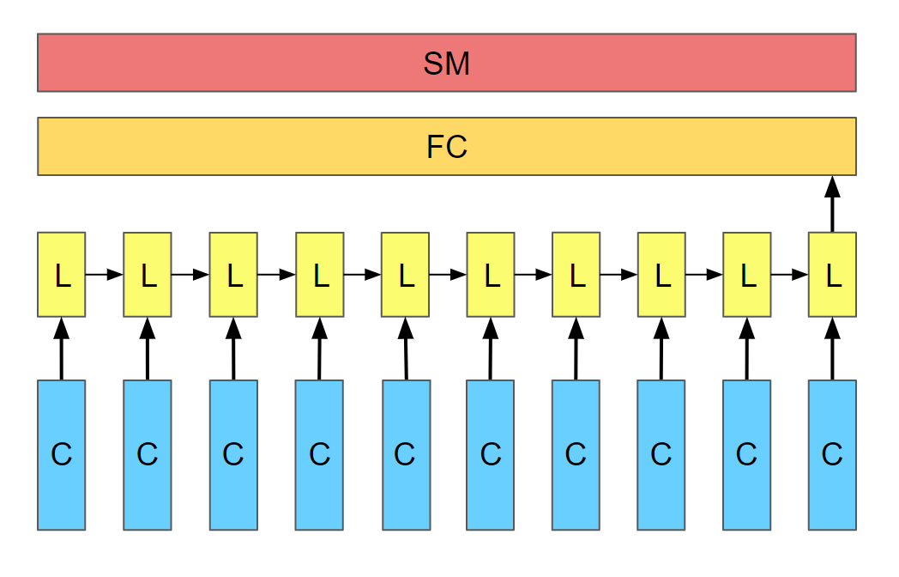
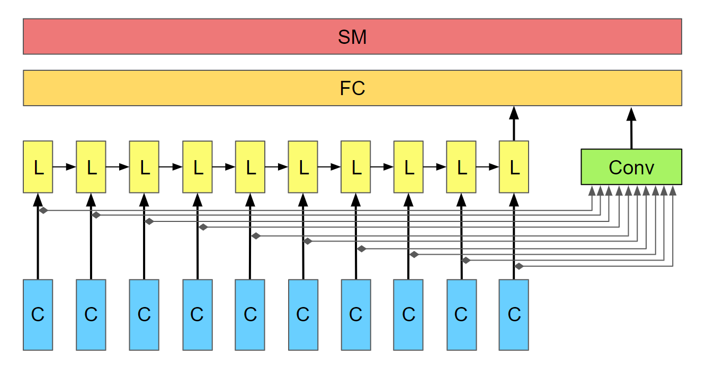
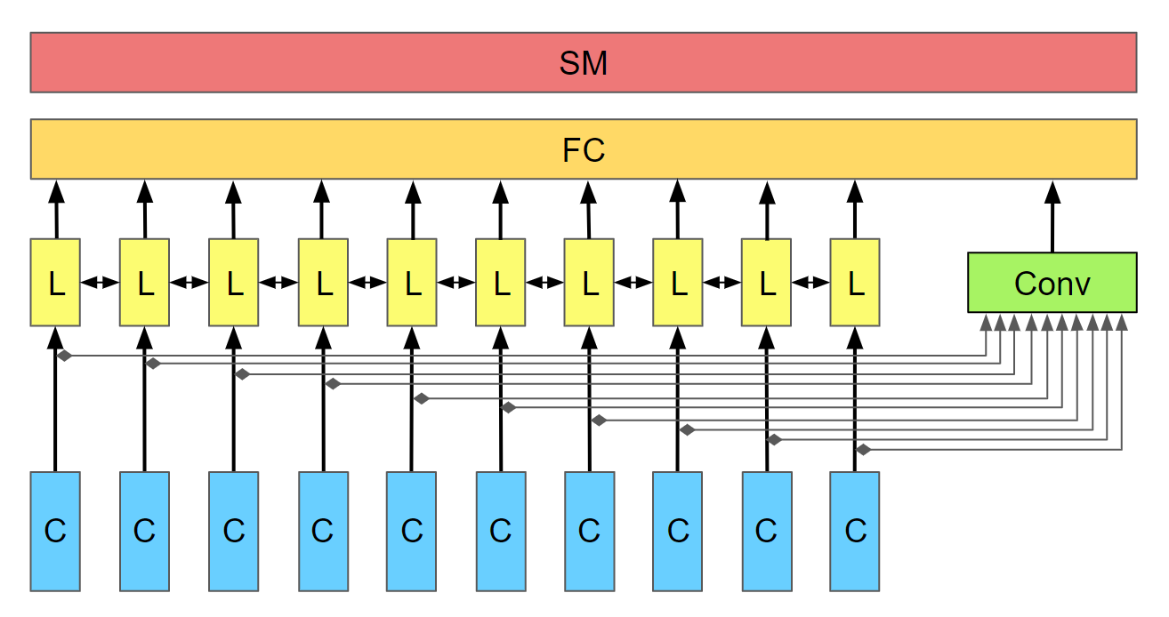
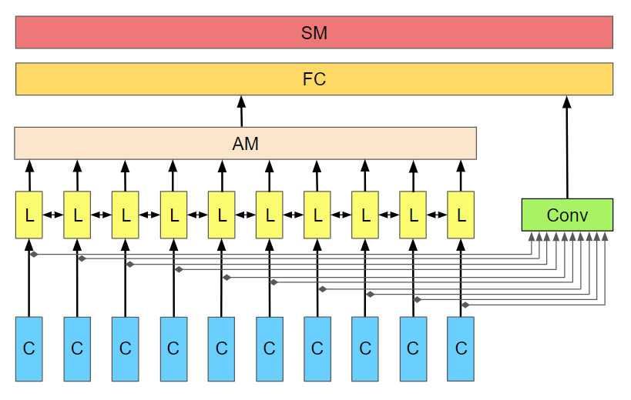
A) LSTM
B) Mixed LSTM / 1D Conv
C) Mixed BiLSTM / 1D Conv
D) Mixed Att-BiLSTM / 1D Conv

Slide 25
SM
FC
AM
L
L
L
L
L
L
L
L
L
L
Conv
C
C
C
C
C
C
C
C
C
C

Slide 26
SM
FC
L
L
L
L
L
L
L
L
L
L
Conv
C
C
C
C
C
C
C
C
C
C

Slide 27
SM
FC
AM
L
L
L
L
L
L
L
L
L
L
L
L
L
L
L
L
L
L
L
L
Conv
C
C
C
C
C
C
C
C
C
C

Slide 28
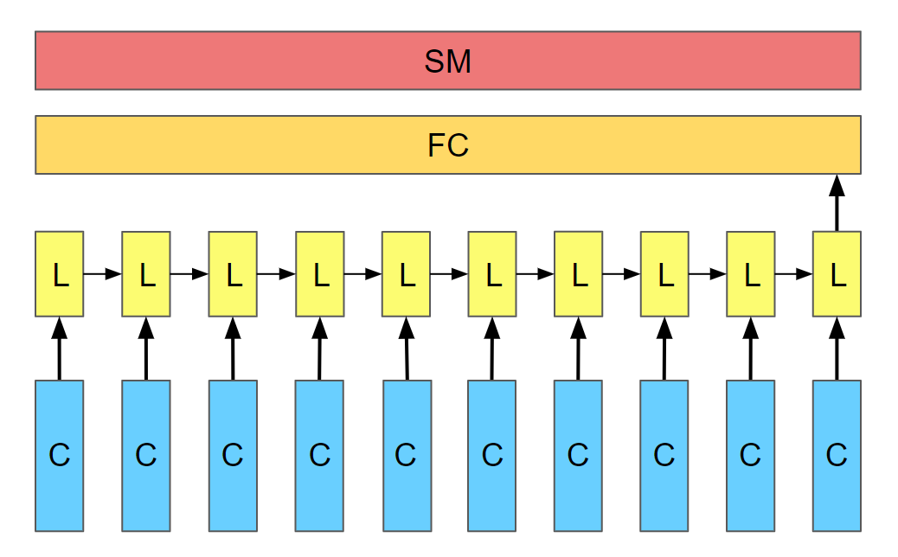
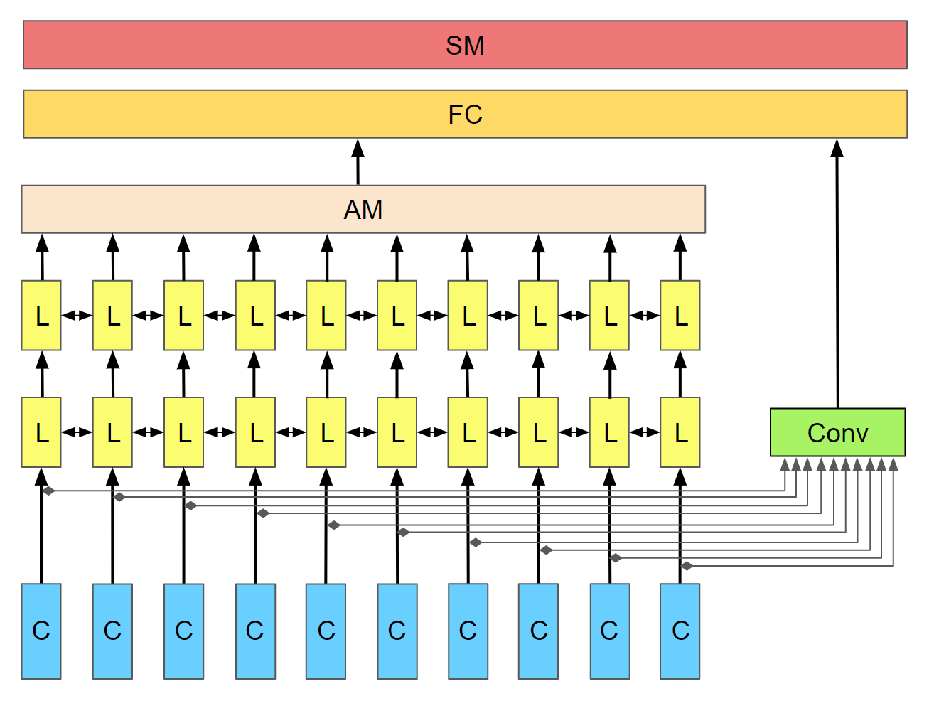

Slide 29
SM
FC
L
L
L
L
L
L
L
L
L
L
Conv
C
C
C
C
C
C
C
C
C
C

Slide 30
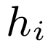
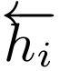
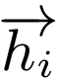
Attention layer
LSTM layer
CNN
layer
C
C
C
C
C
C
C
C
C
C

Slide 31
Attention layer
LSTM layer
CNN
layer
C
C
C
C
C
C
C
C
C
C

Slide 32
SM
FC
AM
L
L
L
L
L
L
L
Conv
C
C
C
C
C
C
C

Slide 33
Hidden Layers
Input Layer
a^{[1]}₁
a^{[2]}₁
a^{[3]}₁
Output Layer
a^{[1]}₂
a^{[2]}₂
a^{[3]}₂
a^{[4]}
Ŷ
X
a^{[1]}₃
a^{[2]}₃
a^{[3]}₃
a^{[1]}_{n}
a^{[2]}_{n}
a^{[3]}_{n}
X = A^{[0]}
A^{[1]}
A^{[2]}
A^{[3]}
A^{[4]}
Notes:
Created By @srvmshr
sourav@yahoo.com

Slide 34
Hidden Layers
Input Layer
^{[1}a]₁
a^{[2]}₁
a^{[3]}₁
Output Layer
a^{[1]}₂
a^{[2]}₂
a^{[3]}₂
a^{[4]}
Ŷ
X
a^{[1]}₃
a^{[2]}₃
a^{[3]}₃
a^{[1]}_{n}
a^{[2]}_{n}
a^{[3]}_{n}
X = A^{[0]}
A^{[1]}
A^{[2]}
A^{[3]}
A^{[4]}
Notes:
Created By @srvmshr
sourav@yahoo.com

Slide 35
Hidden Layers
Input Layer
a^{[1]}₁
a^{[2]}₁
a^{[3]}₁
Output Layer
a^{[1]}₂
a^{[2]}₂
a^{[3]}₂
a^{[4]}
Ŷ
X
a^{[1]}₃
a^{[2]}₃
a^{[3]}₃
a^{[1]}_{n}
a^{[2]}_{n}
a^{[3]}_{n}
X = A^{[0]}
A^{[4]}
A^{[1]}
A^{[2]}
A^{[3]}
Notes:
Original by @srvmshr
sourav@yahoo.com
Dark themed version by (Elvis Saravia - ellfae@gmail.com)

Slide 36
CONV operation
MxM
ReLU
+b1
+b1
MxMX2
+b2
+b2
NxNx3
MxM
ReLU
a^{[l-1]}
a^{[l]}
Notes:
Added by @srvmshr
Sourav @ yahoo.com

Slide 37
CONV operation
MxM
ReLU
+b1
+b1
MxMX2
+b2
+b2
NxNx3
MxM
ReLU
Notes:
Added by @srvmshr
Sourav @ yahoo.com

Slide 38
CONV operation
MxM
ReLU
+b1
+b1
MxMX2
+b2
+b2
NxNx3
MxM
ReLU
Notes:
Added by @srvmshr
Sourav @ yahoo.com

Slide 39
Striding in CONV
S=1
S=2
Notes:
Created by @srvmshr
Sourav @ yahoo.com

Slide 40
Inception Module
MaxPool Same s=1
5x5 Same
3x3 Same
NxNx192
1x1 Same
NxNx192
NxNx128
NxNx32
NxNx64
Notes:
Created by @srvmshr
Sourav @ yahoo.com

Slide 41
Notes:
Note:
1 hidden layer neural network
Author: Elvis Saravia (ellfae@gmail.com)

Slide 42
Softmax
Linear
Add & Norm
Feed
Forward
Add & Norm
Add & Norm
Multi-Head
Attention
Feed
Forward
Add & Norm
Add & Norm
Masked
Multi-Head
Attention
Multi-Head
Attention
Positional
Encoding
Positional
Encoding
Input
Embedding
Output
Embedding
Inputs
Outputs (shifted right)
Notes:
Note:
Using the same visual components from before and a few new custom ones, I was able to come up with the Transformer architecture
This is a reproduction of the Transformer architecture figure presented in the work of Vaswani et al. 2017
You can further customize it however you want
Author: Elvis Saravia (ellfae@gmail.com)

Slide 43
Softmax
Linear
Add & Norm
Feed
Forward
Add & Norm
Add & Norm
Multi-Head
Attention
Feed
Forward
Add & Norm
Add & Norm
Masked
Multi-Head
Attention
Multi-Head
Attention
Positional
Encoding
Positional
Encoding
Input
Embedding
Output
Embedding
Inputs
Outputs (shifted right)
Notes:
Note:
Using the same visual components from before and a few new custom ones, I was able to come up with the Transformer architecture
This is a reproduction of the Transformer architecture figure presented in the work of Vaswani et al. 2017
You can further customize it however you want
Author: Elvis Saravia (ellfae@gmail.com)

Slide 44
I
love
coding
and
writing
Tokenize
“I love coding and writing”
Notes:
Note:
This figure aims to demonstrate the process of tokenization
If you want to change the gradient colors of this shape, you can simply click on the shape and then select “Fill color” (the bucket looking icon at the top).
This is a gradient color so you can customize however you want
Author: Elvis Saravia (ellfae@gmail.com)

Slide 45
ML Concepts
Notes:
Note:
Gradient background shows some inspirations and ideas for color themes that could be used for backgrounds
The examples used in this section are inspired by https://uigradients.com

Slide 46
Size
Family?
X
Y
#bed
Walk?
PRICE ŷ
Basic Neuron Model
ZIP
School
How does NN work (Insprired from Coursera)
Wealth
Ŷ = 0
X
Logistic Regression
Ŷ = 1
Notes:
By @srvmshr
sourav@yahoo.com

Slide 47
Linear regression
ReLU(x)
$
$
Size
Size
Notes:
By @srvmshr
sourav@yahoo.com

Slide 48
256
225
56
.
.
.
214
210
211
NxN
NxN
NxN
NxN
R-G-B
Unrolling Feature vectors
Notes:
By @srvmshr
sourav@yahoo.com

Slide 49
Large NN
Med NN
η
Small NN
SVM,LR etc
Amount of Data
Why does Deep learning work?
Notes:
By @srvmshr
sourav@yahoo.com

Slide 50
Hidden
Input
Output
a^{[1]}₁
a^{[1]}₂
One hidden layer neural network
X
a^{[2]}
Ŷ
a^{[1]}₃
a^{[1]}₄
X = A^{[0]}
A^{[1]}
A^{[2]}
Notes:
By @srvmshr
sourav@yahoo.com

Slide 51
a^{[1]}₁
x_{[1]}
a^{[2]}
a^{[1]}₂
x_{[2]}
x_{[1]}
x_{[2]}
x_{[3]}
Neural network templates
Notes:
By @srvmshr
sourav@yahoo.com

Slide 52
Train
Valid
Test
Underfitting
Good fit
Overfitting
x2
x2
x2
x1
x1
x1
Train-Dev-Test vs. Model fitting
Notes:
By @srvmshr
sourav@yahoo.com

Slide 53
x_{[1]}
x_{[2]}
a_{[L]}
DropOut
x_{[3]}
x2
r=1
x2
Normalization
x1
x1
Notes:
By @srvmshr
sourav@yahoo.com

Slide 54
J
w2
Early stopping
Err
w1
w1
w2
Before Normalization
Dev
Train
it.
J
w2
w1
w1
After Normalization
w2
Notes:
By @srvmshr
sourav@yahoo.com

Slide 55
x₁
x₂
w[L]
w[1]
w[2]
w[L-2]
w[L-1]
Deep neural networks
FN
TN
TP
FP
Understanding
Precision & Recall
Notes:
By @srvmshr
sourav@yahoo.com

Slide 56
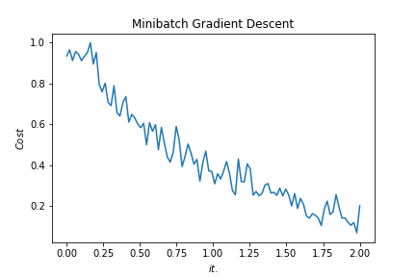
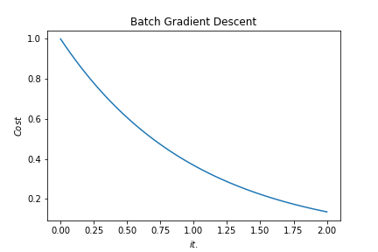
Batch vs. Mini-batch Gradient Descent
w2
w2
BGD
SGD
Batch Gradient Descent vs. SGD
SGD
w1
w1
Notes:
By @srvmshr
sourav@yahoo.com

Slide 57
x_{[1]}
p_{[1]}
x_{[2]}
p_{[2]}
x_{[3]}
Softmax Prediction with 2 outputs
Notes:
By @srvmshr
sourav@yahoo.com

Slide 58
Abstract backgrounds
Notes:
Note:
You can add abstract backgrounds here

Slide 59
Notes:
Note:
You can change the gradient of each component
Author: Elvis Saravia

Slide 60
dair.ai
Notes:
Note:
This is the header I use for the dair.ai NLP Newsletter
You can change the gradient of each component
You can customize the background as well by right clicking and changing to another gradient or static color
Author: Elvis Saravia

Slide 61
Notes:
Note:
This is the header I use for the dair.ai NLP Newsletter
You can change the gradient of each component
Author: Elvis Saravia

Slide 62
Notes:
Note:
This is the header I use for the dair.ai NLP Newsletter
You can change the gradient of each component
Author: Elvis Saravia

Slide 63
Gradient Backgrounds
Notes:
Note:
Gradient background shows some inspirations and ideas for color themes that could be used for backgrounds
The examples used in this section are inspired by https://uigradients.com

Slide 67
ML and Health

Slide 68
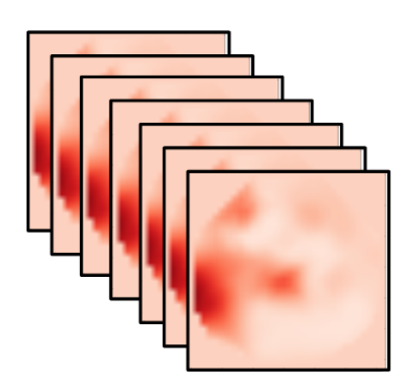
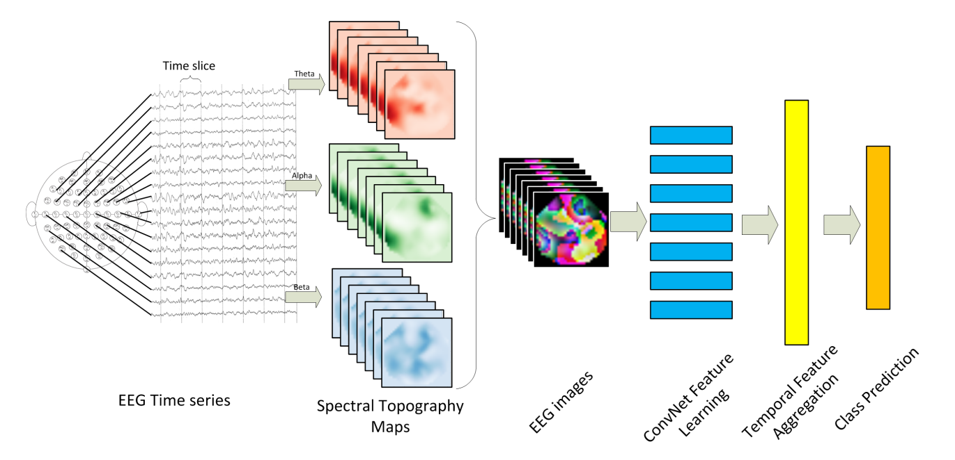
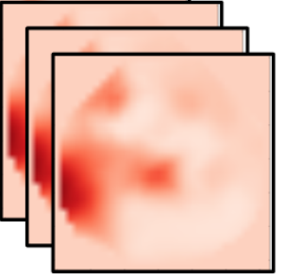
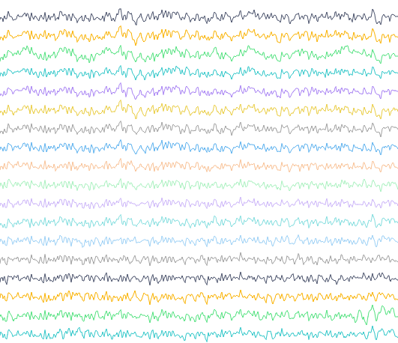
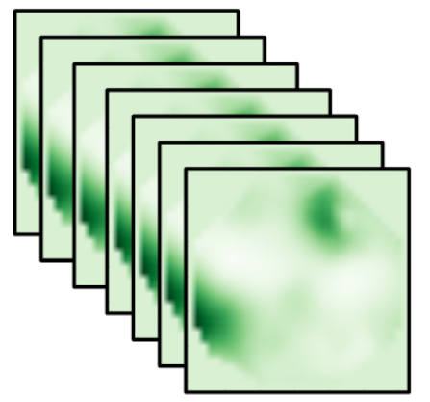
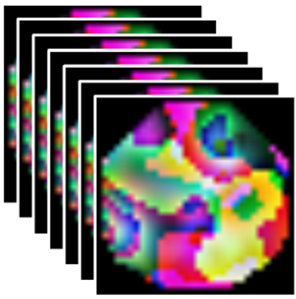
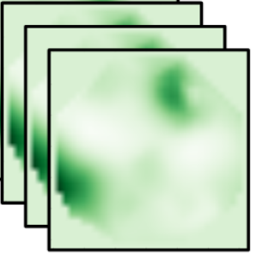
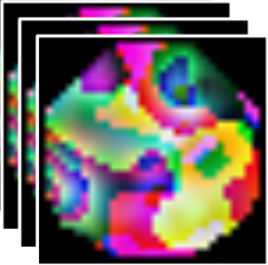
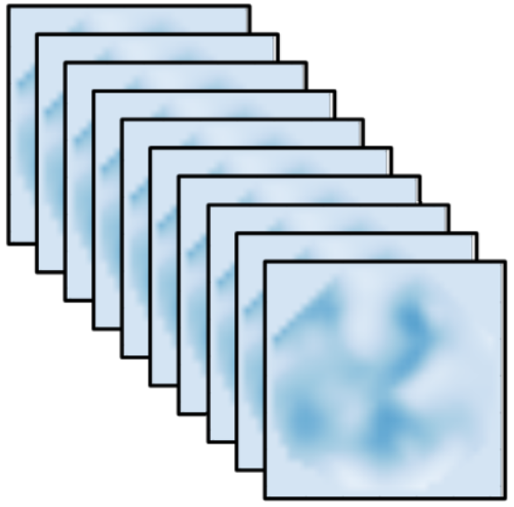
Time slice
Delta
Alpha
Conv
ICA
Conv
Conv
LSTM+AM
Conv
Conv
Alpha
Conv
Conv
Conv
Conv
Conv
Conv
Conv
Conv
Beta
Conv
Conv
Conv
Conv
EEG Time Series
Pain Intensity Assessment
Spectral Topography Maps
Spatial Feature Learning
Temporal Feature Aggregation
EEG Images
Notes:
Note:
These visuals can represent a multi-directional array (3D)
Author: Elvis Saravia (ellfae@gmail.com)

Slide 70
Time slice
Theta
Alpha
Conv
ICA
Conv
Conv
LSTM+AM
Conv
Conv
Alpha
Conv
Conv
Conv
Conv
Conv
Conv
Conv
Conv
Beta
Conv
Conv
Conv
Conv
EEG Time Series
Temporal Feature Aggregation
Pain Intensity Assessment
Pain Location Assessment
Spectral Topography Maps
EEG Images
Spatial Feature Learning
Notes:
Note:
These visuals can represent a multi-directional array (3D)
Author: Elvis Saravia (ellfae@gmail.com)

Slide 71
Conv
Conv
Conv
Conv
Conv
Conv
Conv
Conv
Conv
Conv

Slide 72
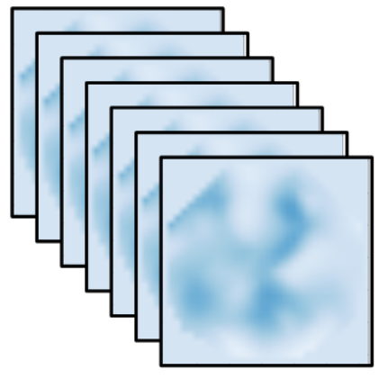


Slide 74
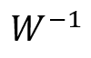
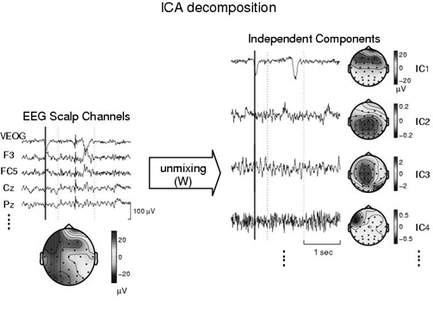
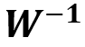
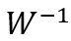
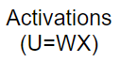
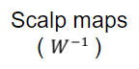
Activations
(U=WX)
Scalp maps
( )

Slide 75
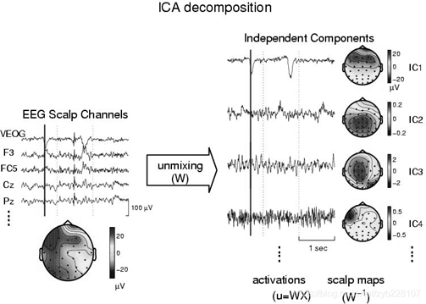



Slide 76




Slide 77


Slide 78
Test Subject | S1 | S2 | S3 | S4 | S5 | S6 | S7 | S8 | S9 | S10 | S11 | S12 | S13 | Average Accuracy
Pain Intensity | 0.8209 | 0.8882 | 0.9569 | 0.9625 | 0.9322 | 0.9563 | 1 | 0.9707 | 0.9809 | 0.9226 | 0.9015 | 0.892 | 0.8094 | 0.922623077
Pain Location | 0.7243 | 0.8028 | 0.9397 | 0.9951 | 0.9286 | 1 | 0.9948 | 0.9088 | 0.8844 | 0.8956 | 0.8816 | 0.7081 | 0.7591 | 0.878684615

Slide 79


Slide 80



Slide 81
Withdraw
hand
Immerse
hand
Level 1
Level 2
Level 3
Level 4
No Pain
Low Pain
Moderate Pain
High Pain
Time
Signal Segmentation
Notes:
Note:
Can represent a multidimensional array (2D)
Author: Elvis Saravia (ellfae@gmail.com)

Slide 82
Level 1
Level 2
Level 3
Level 4
No Pain
Low Pain
Moderate Pain
High Pain
Time
Immerse
hand
Withdraw
hand
Notes:
Note:
Can represent a multidimensional array (2D)
Author: Elvis Saravia (ellfae@gmail.com)

Slide 83


Slide 84




AEP
Bicubic
PSD
Spectral Topography Map
Theta(4~8Hz)
Alpha(8~13Hz)
Beta(13~30Hz)
FFT
Image Generation

Slide 85
Input
Conv3-32
x4
Maxpool
(2x2)
Conv3-64
x2
32x32x3
Maxpool
(2x2)
Conv3-
128
Maxpool
(2x2)
Output
FC-512
Feature
Vector
ConvNet Configuration
Notes:
Note:
These visuals can represent a multi-directional array (3D)
Author: Elvis Saravia (ellfae@gmail.com)

Slide 86
Layer1
Layer2
Layer3
Layer1
Layer2
Layer3
Layer4
Input
Output
Conv3-32
Conv3-32
Conv3-32
Conv3-32
Max-Pool
Conv3-64
Max-Pool
Conv3-128
Max-Pool
Conv3-64
FC-512
Input
Conv
Max-Pool
Conv
Max-Pool
FC
FC
Softmax
ConvNet Configuration
Stack1
Stack2
Stack3
Stack4
Conv3-32
Output
Conv3-32
Conv3-32
Conv3-32
Max-Pool
Conv3-64
Max-Pool
Conv3-128
Max-Pool
Conv3-64
FC-512
Notes:
By @avsthiago

Slide 87
Stack1
Stack2
Stack3
Stack4
Conv3-32
Conv3-32
Max-Pool
Output
Conv3-64
Max-Pool
Conv3-128
Max-Pool
Conv3-64
FC-512
Conv3-32
Conv3-32

Slide 88

Time
Unbearable
Pain
Level 5
Level 4
High
Pain
MediumPain
Level 3
Level 2
LowPain
Level 1
No Pain
(a)
(b)

Slide 89
Level 1
Level 2
Level 3
Level 4
Level 5
Time
No Pain
LowPain
MediumPain
High
Pain
Unbearable
Pain
(a)
(b)

Slide 90

Notes:
Note:
Can represent a multidimensional array (2D)
Author: Elvis Saravia (ellfae@gmail.com)

Slide 91


Notes:
Note:
Can represent a multidimensional array (2D)
Author: Elvis Saravia (ellfae@gmail.com)

Slide 92
Miscellaneous

Slide 93
3
16+32
16
16
16
16
1
Convolution 3x3
Convolution 1x1
Dropout 0.1
Max Pooling 2x2
Skip connection
Dropout 0.2
Up Sampling 2x2
Block copied
Dropout 0.3
32
32
32+64
32
64
64
64+128
64
128
128
128+256
128
256
256
Notes:
By @avsthiago

Slide 94
Layer1
Layer2
Layer3
Layer1
Layer2
Layer3
Layer4
Input
Output
Conv3-32
Conv3-32
Conv3-32
Conv3-32
Max-Pool
Conv3-64
Max-Pool
Conv3-128
Max-Pool
Conv3-64
FC-512
Input
Conv
Max-Pool
Conv
Max-Pool
FC
FC
Softmax
Layer1
Layer2
Layer3
Layer4
Conv3-32
Output
Feature
Vector
Conv3-32
Conv3-32
Conv3-32
Max-Pool
Conv3-64
Max-Pool
Conv3-128
Max-Pool
Conv3-64
FC-512
Notes:
By @avsthiago

Slide 95
Filter concatenation
3x3 convolutions
5x5 convolutions
1x1 convolutions
1x1 convolutions
1x1 convolutions
1x1 convolutions
3x3 max pooling
Previous layer
Notes:
By @avsthiago

Slide 96
Filter concatenation
3x3 convolutions
5x5 convolutions
1x1 convolutions
1x1 convolutions
1x1 convolutions
1x1 convolutions
3x3 max pooling
Previous layer
Notes:
By @avsthiago

Slide 97
Output
Inception 2
Inception 2
Inception 2
Inception 1
FC
FC
1x7 conv
1x7 conv
1x11 conv
1x11 conv
Input

Slide 98
Previous layer
1x3 conv,
1 padding
1x3 conv,
1 padding
1x7 conv,
3 padding
1x3 conv,
1 padding
1x5 conv,
2 padding
1x3 conv,
1 padding
Filter concatenation

Slide 99
Avg-Pool
Auxiliary Classifier
Conv
FC
FC
Softmax
Inception
Input
Inception
Conv
Max-Pool
Conv
Max-Pool
Conv
Max-Pool
Inception
Inception
Max-Pool
Inception
Inception
Inception
Inception
Inception
Max-Pool
Avg-Pool
Conv
FC
Softmax
Avg-Pool
Auxiliary Classifier
Conv
FC
FC
Softmax
Notes:
By @avsthiago

Slide 100
Filter concatenation
Filter concatenation
3x3 conv.
1x3 conv.
3x1 conv.
1x1 conv.
3x3 conv.
3x3 conv.
1x1 conv.
1x3 conv.
3x1 conv.
3x3 conv.
1x1 conv.
1x1 conv.
Pool
1x1 conv.
1x1 conv.
Pool
1x1 conv.
1x1 conv.
Previous layer
Previous layer
(a)
(b)
Notes:
By @avsthiago

Slide 101
Previous input
Previous input
x
x
F(x)
F(x)
Stacked layers
Stacked layers
x
identity
+
y=F(x)
y=F(x)+x
R1
R1
R2
R1
R1
R2
R3
R1
R2
R3
Notes:
By @avsthiago

Slide 102
Dense Block 1
Dense Block 2
Dense Block 3
Softmax
FC
Avg-Pool
Avg-Pool
Conv
Conv
Input
Avg-Pool
Conv
Transition layers
Notes:
By @avsthiago

Slide 103

h_{i+1}
Filter concatenation
h_{i+1}
add
add
Filter concatenation
3x3 max
3x3 conv
3x3 avg
identity
add
add
add
add
add
add
add
add
3x3 conv
identity
3x3 conv
5x5 conv
3x3 avg
identity
3x3 avg
3x3 avg
3x3 conv
5x5 conv
7x7 conv
5x5 conv
3x3 max
7x7 conv
3x3 avg
5x5 conv
h_{i}
h_{i}
...
...
h_{i-1}
h_{i-1}
(a)
(b)
Notes:
By @avsthiago

Slide 104
Notes:
By @avsthiago

Slide 105
Notes:
By @avsthiago
Dark-theme version of the previous (by Elvis Saravia)

Slide 106
Max(1,1,5,6) = 6
Y
1
1
2
4
5
6
7
8
6
8
3
2
1
0
Pooling performed with a 2x2 kernel and a stride of 2
3
4
1
2
3
4
X
Image Representation
Notes:
By @avsthiago

Slide 107
ML System Design / Infrastructure

Slide 108
APP
疼痛等级
治疗力度
脑电波头盔
疼痛治疗仪
疼痛位置
治疗方案
使用者的治疗时长、治疗方案、治疗反馈记录
Notes:
Note:
Can represent a multidimensional array (2D)
Author: Elvis Saravia (ellfae@gmail.com)

